Slide 1
Deploying SharePoint Framework components to production
Deploying to SharePoint CDN

Slide 2
Agenda
Create SharePoint CDN
Enable SharePoint CDN
Configure web part to use CDN
Build, deploy, install, and test
Q&A

Slide 3
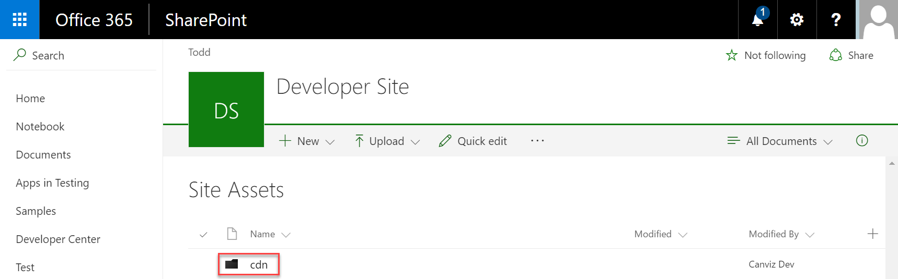
Create SharePoint CDN origin
Go to the Site Assets Document Library
Create a folder for the CDN origin

Slide 4
Enable the SharePoint CDN origin
Open the SharePoint Online Management Shell
Execute the following Powershell commands to enable the CDN, set the CDN origin, and return the CDN Origin ID
> $creds = Get-Credential
> Connect-SPOService -Url https://<TENANCY>-admin.sharepoint.com/ -Credential $creds
> Set-SPOTenant -PublicCdnEnabled $true
> Set-SPOTenant -PublicCdnAllowedFileTypes "CSS,EOT,GIF,ICO,JPEG,JPG,JS,MAP,PNG,SVG,TTF,WOFF,TXT"
> New-SPOPublicCdnOrigin -Url "https://<TENANCY>.sharepoint.com/sites/<SITE>/siteassets/cdn"
> Get-SPOPublicCdnOrigins
Notes:
Open the SharePoint Online Management Shell.
Connect to your Office 365 Developer Tenant within PowerShell session by executing the following commands:
$creds = Get-Credential
Connect-SPOService -Url https://<TENANCY>-admin.sharepoint.com/ -Credential $creds
Enable the Public CDN in the tenant by executing the following command:
Set-SPOTenant -PublicCdnEnabled $true
Configure the allowed file extensions by executing the following command:
Set-SPOTenant -PublicCdnAllowedFileTypes "CSS,EOT,GIF,ICO,JPEG,JPG,JS,MAP,PNG,SVG,TTF,WOFF,TXT“
Add the CDN Origin by executing the following command:
New-SPOPublicCdnOrigin -Url "https://<TENANCY>.sharepoint.com/sites/dev/siteassets/cdn“
Get the CDN Origin Id by executing the following command:
Get-SPOPublicCdnOrigins

Slide 5
Configure the web part to use the CDN
Create CDN base path
Update the cdnBasePath in the write-manifests.json file
https://publiccdn.sharepointonline.com/<TENANCY>.sharepoint.com/<your-CDN-origin-Id>
{
"cdnBasePath": "https://publiccdn.sharepointonline.com/<TENANCY>.sharepoint.com/<your-CDN-origin-Id>"
}
Notes:
Your CDN base path should be: https://publiccdn.sharepointonline.com/<TENANCY>.sharepoint.com/<your-CDN-origin-Id>. Replace the <TENANCY> placeholder with the name of your Office 365 site, and the <your-CDN-origin-Id> placeholder with the CDN Origin Id you created in the previous steps.

Slide 6
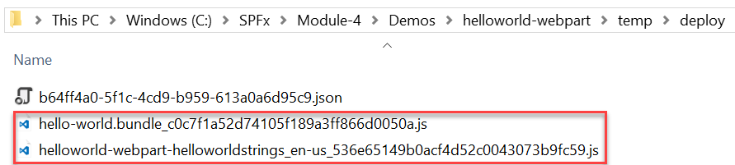
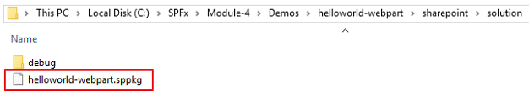
Package the web part
Use the bundle gulp task to build, localize, and bundle the project
Use the package-solution gulp task to package the project into a .sppkg file
The ship parameter build task creates a minified version of the bundle and copies all of the web part assets, including the web part bundle, into the temp\deploy folder. The .sppkg folder is generated in the sharepoint\solution folder.
> gulp bundle --ship
> gulp package-solution --ship

Slide 7
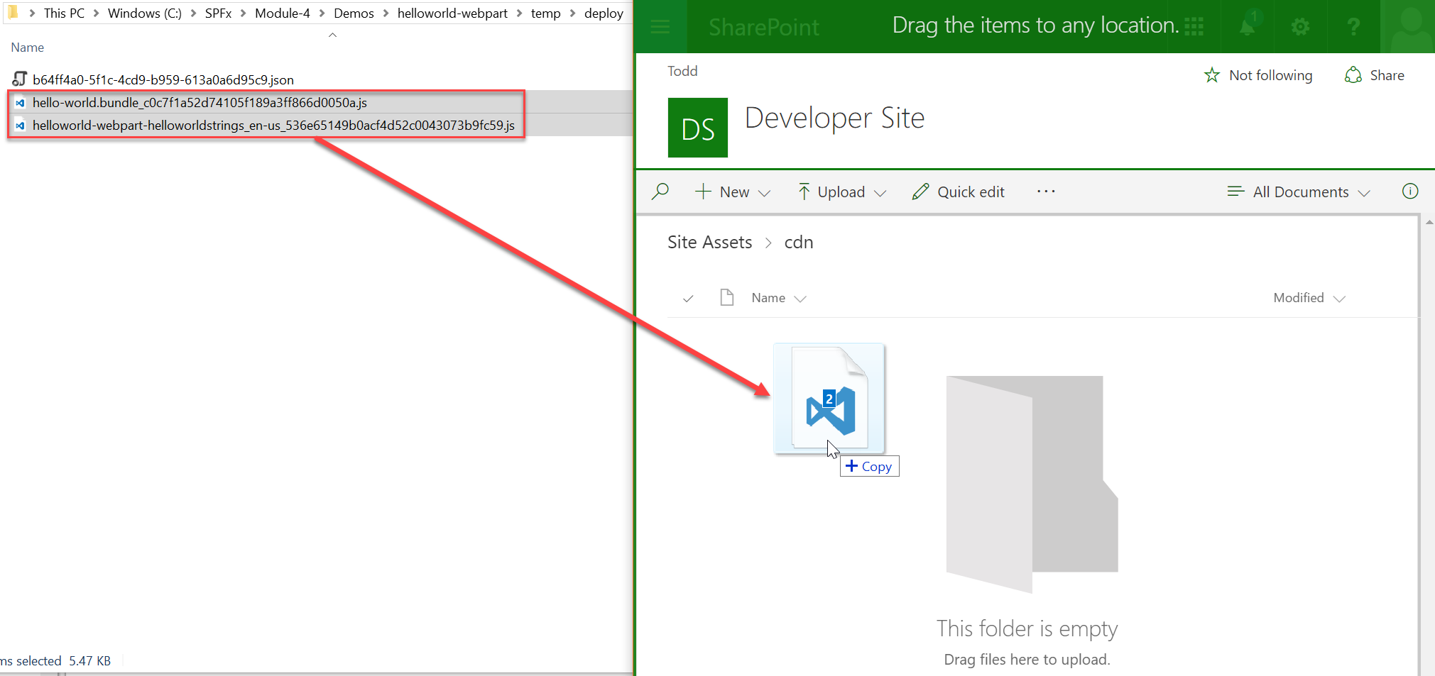
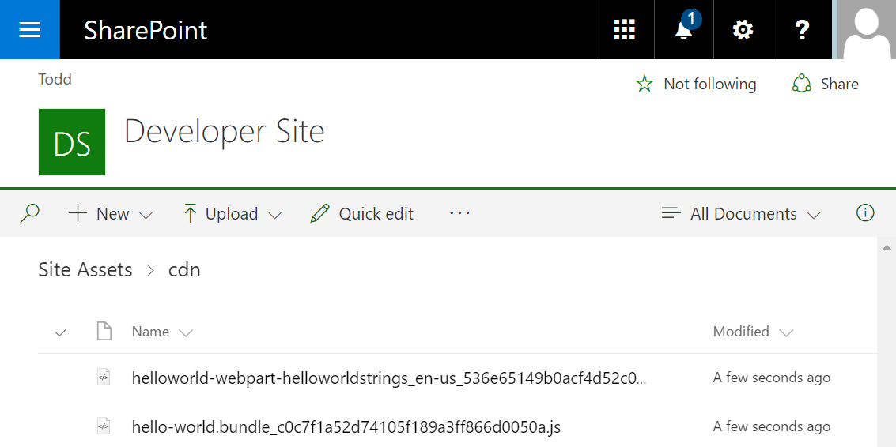
Deploy web part assets to the SharePoint CDN
Go to the Site Assets Document Library
Upload the assets for your web part to the CDN enabled folder

Slide 8
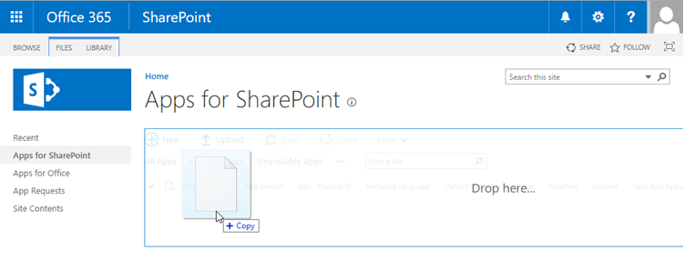
Deploy App to the SharePoint App Catalog
Go to your Office 365 App Catalog site
In the left sidebar, choose Apps for SharePoint
Upload the package (.sppkg file) for the web part

Slide 9
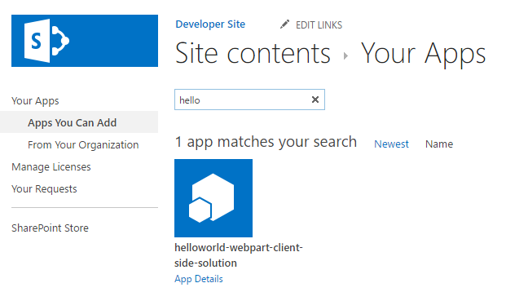
Install the App
Go to your Office 365 site
Go to the Site Contents page
Add the App you just deployed to the SharePoint App Catalog

Slide 10
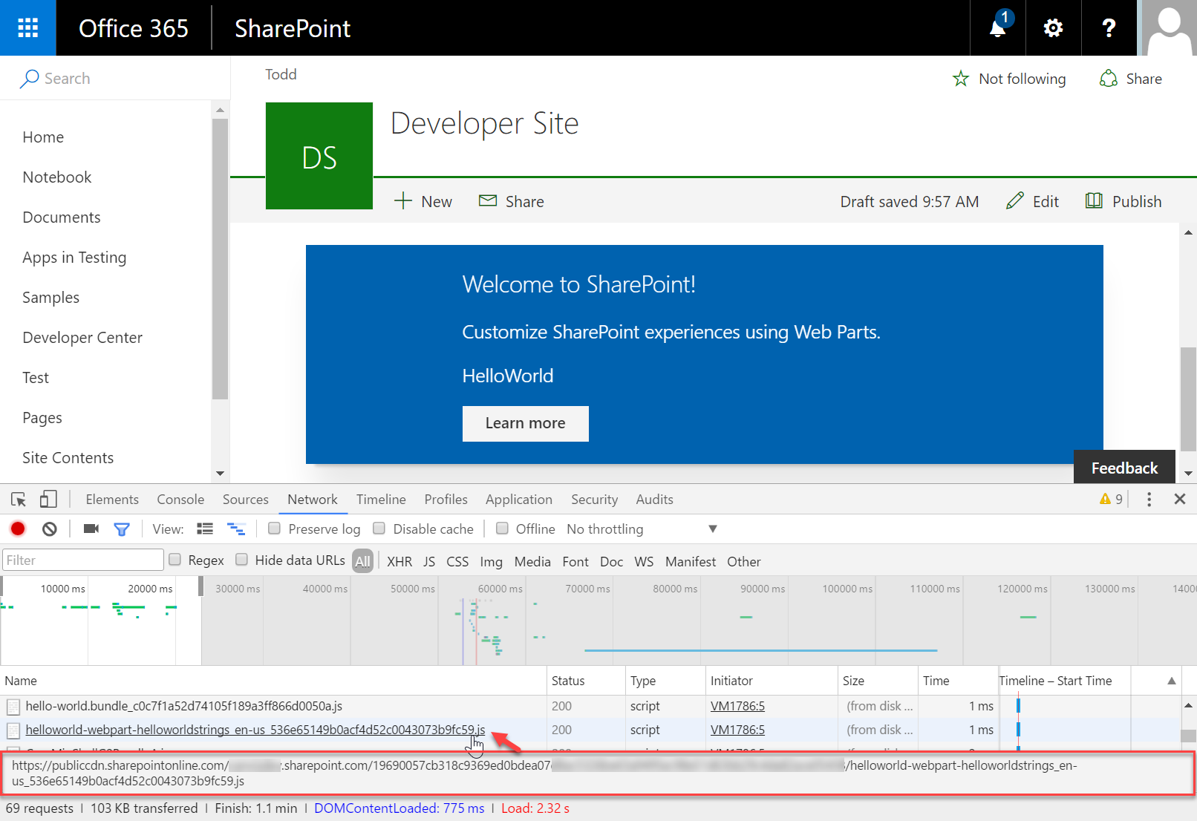
Add the web part to a SharePoint page
After the web part assets are deployed to a CDN location you can preview the web part
Create a page on your Office 365 site and add the web part to the page
In the developer console verify the assets are served from the CDN

Slide 11
DEMO
Deploy web part resources to a SharePoint CDN
Notes:
Use Exercise 2: Deploy the web part resources to a SharePoint CDN in the lab manual.

Slide 12
Summary
Create SharePoint CDN
Enable SharePoint CDN
Configure web part to use CDN
Build, deploy, install, and test
Q&A

Slide 13
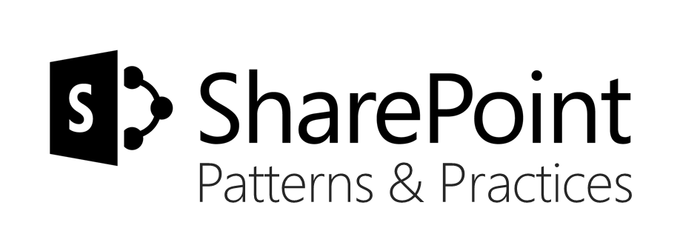
Sharing is caring…
Code samples and solutions
Reusable components
Guidance documentation
Monthly community calls
SharePoint Framework
SharePoint add-ins
Microsoft Graph
Office 365 APIs
http://aka.ms/SharePointPnP

Slide 14

Q&A

Slide 15


